Slide 1
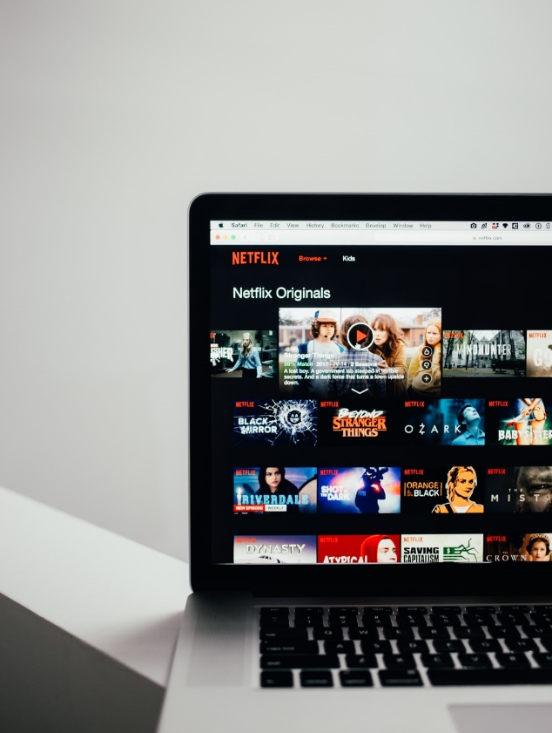
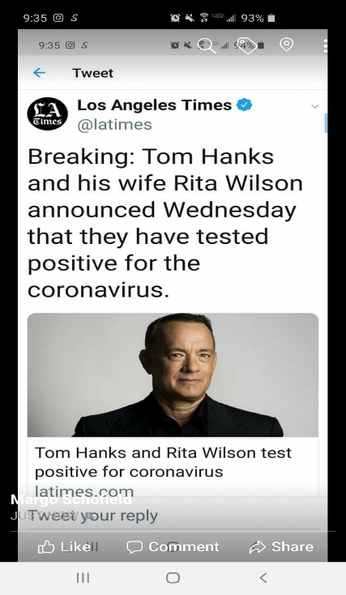
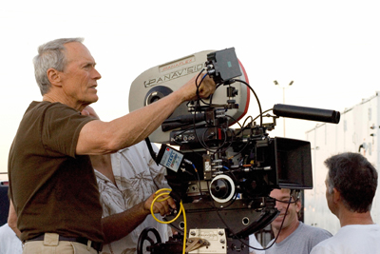
Conversation Class
Christopher bAUMAN

Slide 2
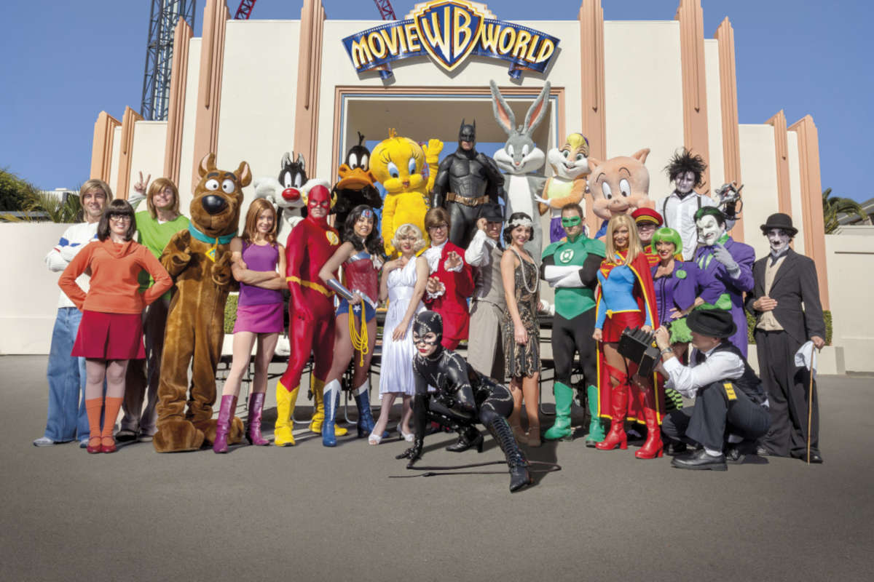
Education Infographic
Responsibility
Influencers
Insta
Tweet
Social media
Movie extra
Struggle
Risk
Genre
Chris Bauman

